Slide 1
Talking
Understanding
Attention & listening
Social interaction / attachment
Speech
a pyramid of books?
yes - one for each layer!
Notes:
1

Slide 2
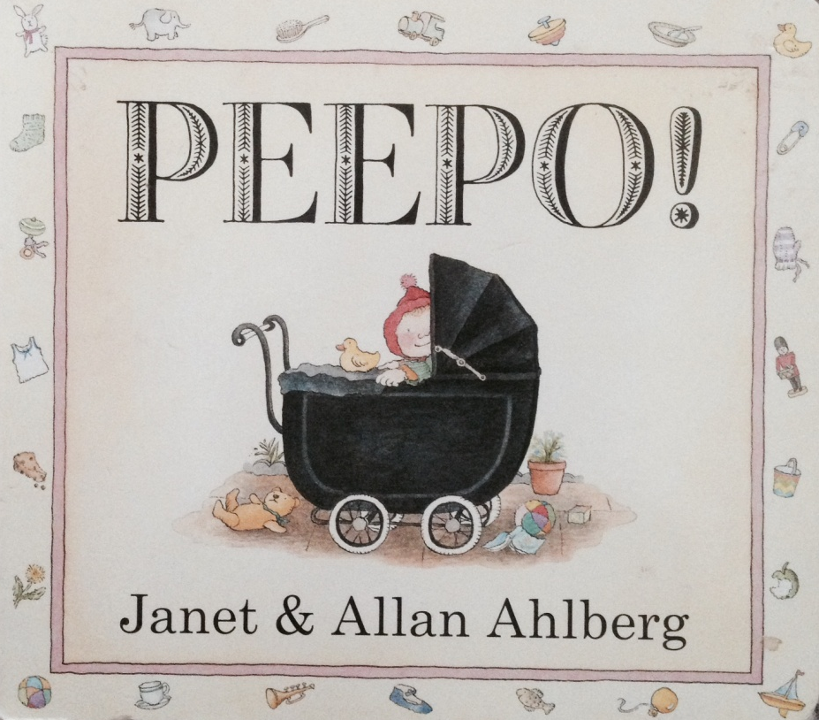
here’s one for attachment and social interaction
there are holes to peep through and lots of funny things from the olden days to make you smile!

Slide 3

here’s one for attention and listening
there are lots of flaps to look under and the rhymes help me listen and wait for the next bit!

Slide 4
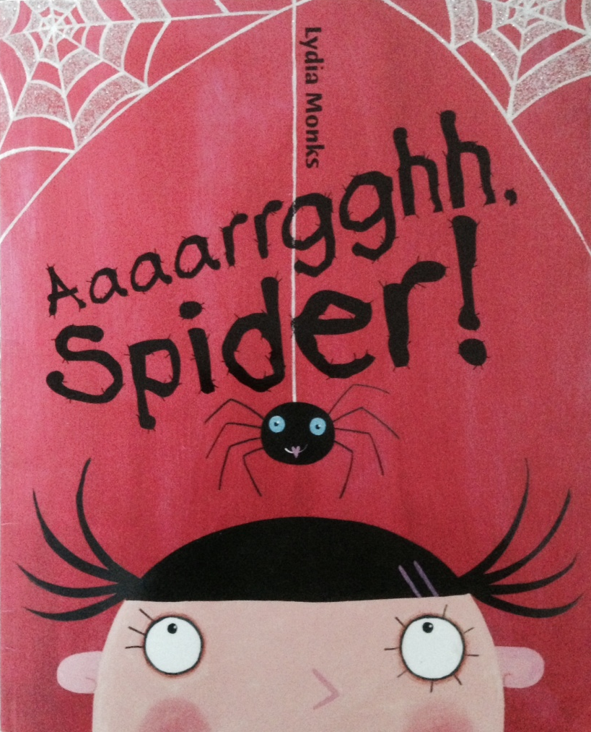
here’s one for understanding
the words are simple and the same phrases are repeated lots of times – ‘out you go!’

Slide 5
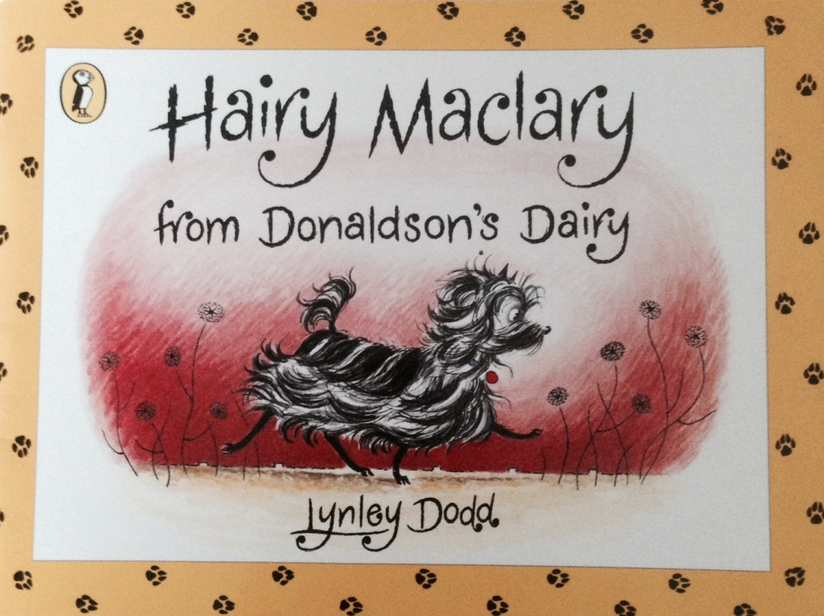
here’s one for talking
there are loads of new words like ‘sniffed’ and ‘snooped’ and ‘yowl’ and ‘howl’

Slide 6
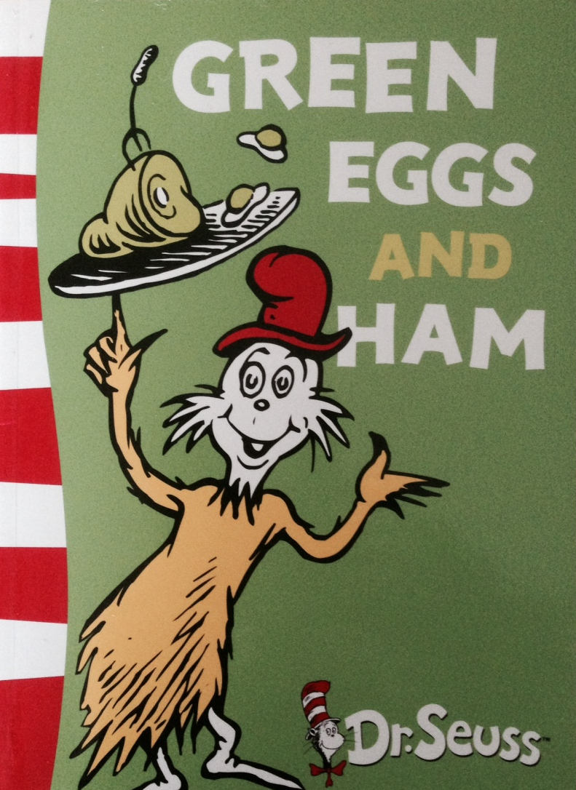
here’s one that’s great for speech sounds
the rhymes help me learn about sounds... that ‘mouse’ sounds different from ‘house’

Slide 7

have a go too – send us your very own pyramid of books...
click to find out how...

Slide 8
download this PowerPoint from the ‘time to talk’ website www.timetotalkwarwickshire.wordpress.com/events/chattermattersweek2015
cut and paste photographs of your own favourite books and explanations as to how they help each level of the pyramid
send it back to us, and we’ll put it in our website gallery!
e-mail to: deborah.powers@swft.nhs.uk
thank you!

