Slide 1




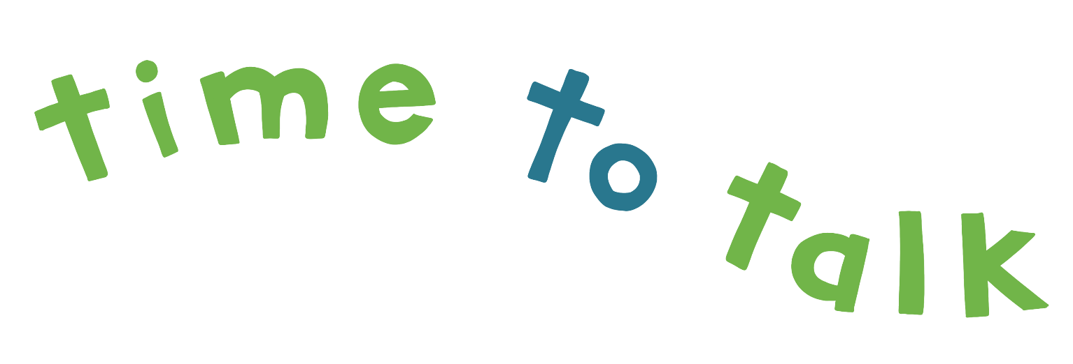

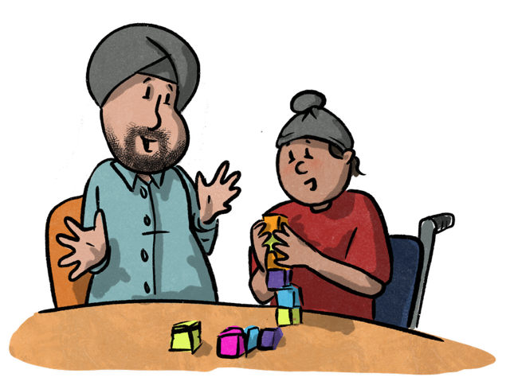
TM
to your
4 year old
Ages and Stages
of Speech, Language and Communication

Slide 2
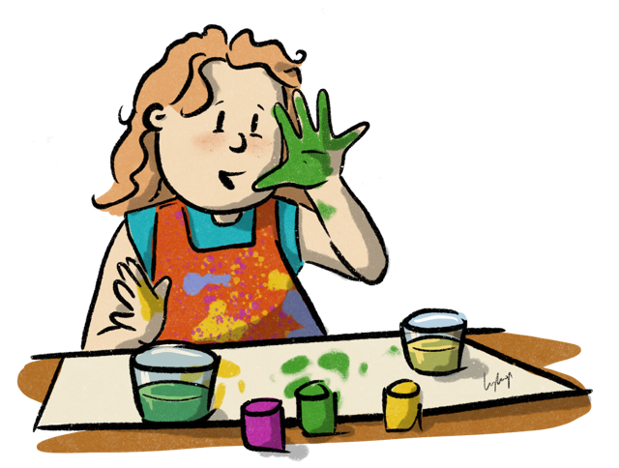
Can you believe it? Now I’m four, I can…
…use lots of speech sounds in the correct way when I am talking. Some sounds are still a little tricky e.g. ‘th’ ‘r’ ‘ch’ j’ and ‘l’
…use basic grammar when I am talking. There will still be some mistakes with trickier grammar e.g. “I goed to the park”!
…understand words that describe features like ‘hot’ and ‘cold’, ‘long’ and ‘short’
…use lots and lots of words – maybe even 1000!
…use sentences and link them together with joining words e.g. ‘and’ ‘then’
…understand language that relates to time like ‘yesterday’ ‘tomorrow’
…move my attention more easily from what I am playing to someone speaking to me. I can even return my attention to the game I was playing.
…play with my friends using my words to share my ideas and thoughts
All children follow their own unique pattern of development.
This is a general guide to how children typically learn to communicate at this age. It is not a screening tool, rather information to help you think about how you can help your child’s communication skills excel.

Slide 3
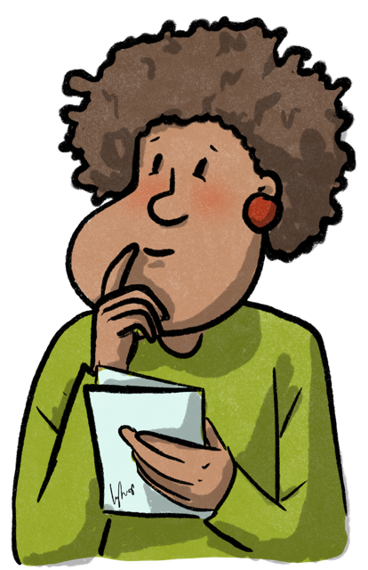
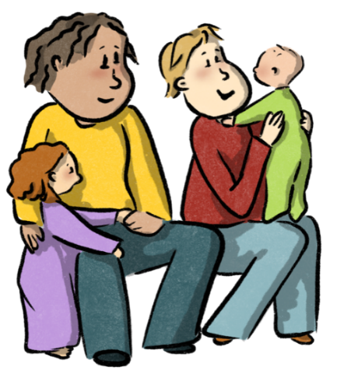
Helpful Hints
Here’s some ideas to help all children to develop their communication skills
I love to hear your conversation. Talk to me about what has been happening today, yesterday and what will happen tomorrow. Pop your phone away when we chat.
Sing nursery rhymes and songs with me. The pattern of rhymes helps me learn about sounds and listening.
Games like ‘Simon Says’ and musical statues help my listening skills!
I love to play and enjoy having you play with me. We could play make-believe games and pretend to be dragons or fairies or…
Talk about lots of different things. This helps me build my word bank and hear different types of words.
Books help me experience new words too. Share a book with me every day. Rhyming ones are great! Maybe I can tell you about my favourite stories.
Play simple board games with me as I learn to wait and take turns with others.
Because my language is developing so much, I might start to stumble on some of my words. This is OK! I just need you to give me time to finish my idea. Try not to interrupt or answer for me.
Celebrate your home language
Talk, sing and read to me in our home language, it makes me feel included and helps me learn English too!

Slide 4
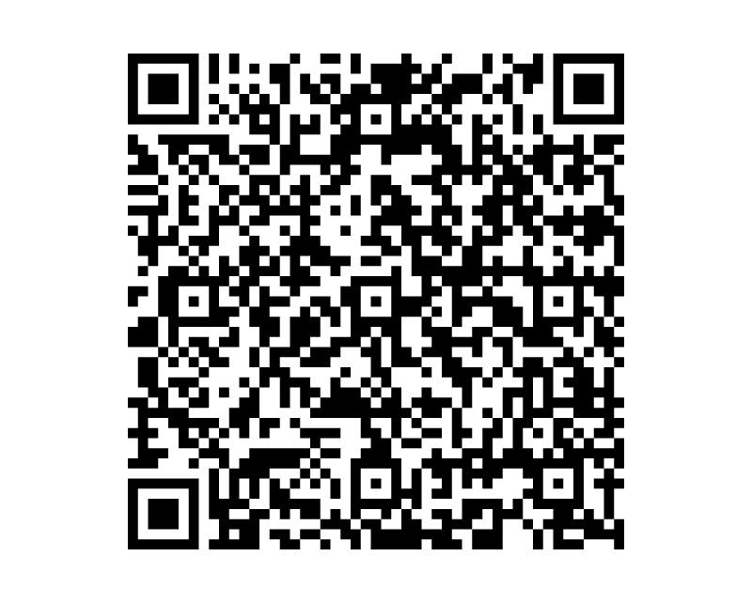
Don’t forget...
No matter what age I am, one of the best ways to help my speech and language development is to have some special quiet time with me so we can talk, play, sing nursery rhymes or look at books.
Make ‘time to talk’ a priority
Where to get more information:
If you’d like to know more about how to help
your child learn to communicate, then take a
look at our website:
www.timetotalkwarwickshire.co.uk
If you have any questions or concerns, then contact your Warwickshire Health Visitor or local Children & Family Centre
As a service, we aim to provide fair and equal access to all experiences, backgrounds and differences. If you feel we can make reasonable adjustments to support you with accessing our material, please speak to the person sharing this information with you or contact the team using the details above.
Author | ‘time to talk’ team
Department | Children’s Speech & Language Therapy
Published
Review
Version No. | 1.0
SWH No.
Images created for SWFT, Speech & Language Therapy department by: Alice Goode,
creating as: Lythop Art Please do not duplicate without permission.

